Slide 1



Hardware and Software Fundamentals of Intelligent Computing Systems

Slide 2
Lecture 28: Data Parallelism

Slide 3
Introduction to DP/DDP
ZeRO-1/2/3, FSDP
Memory/Communication Comparison

Slide 4
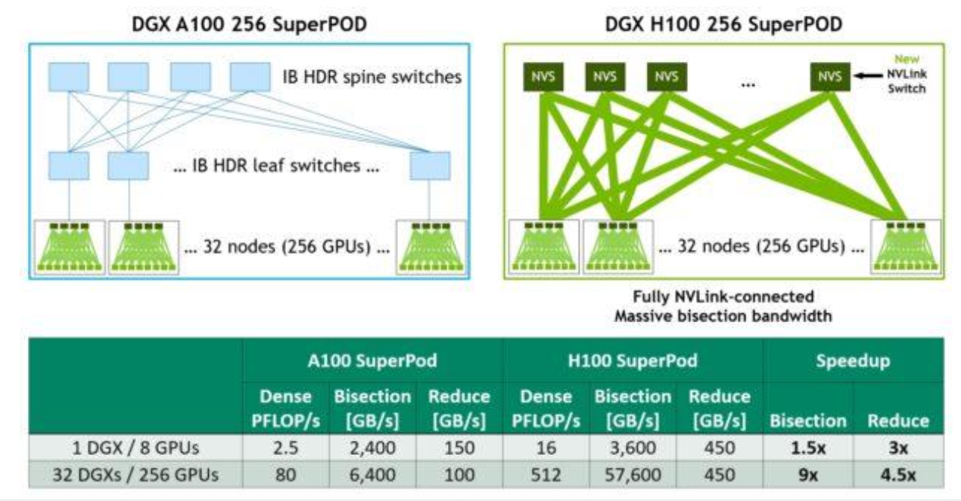
Introduction to Distributed LLM Training
Transition from foundational LLM inference to the computational realities of training.
Inference memory is dominated by model weights and transient KV cache.
Training introduces a massive memory footprint due to the need to preserve the entire computational graph and maintain high-precision optimizer states.
A single hardware accelerator is insufficient; computation and memory must scale horizontally.
Introduction to the three core paradigms
Data Parallelism, Tensor Parallelism, and Pipeline Parallelism.
Split memory/compute across GPUs and machines

Slide 5
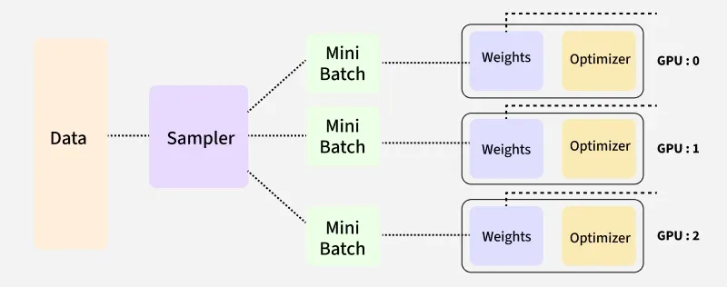
Introduction to Data Parallelism (DP)
Data Parallelism (DP) is the foundational distributed training strategy.
Operates under the Single-Program Multiple-Data (SPMD) paradigm.
The training dataset is partitioned into non-overlapping mini-batches.
Every GPU receives a complete, identical replica of the model weight and optimizer states.
Each accelerator computes forward and backward passes independently on its respective data shard.
DistributedDataParallel (DDP) is the standard module for DP in PyTorch.

Slide 6
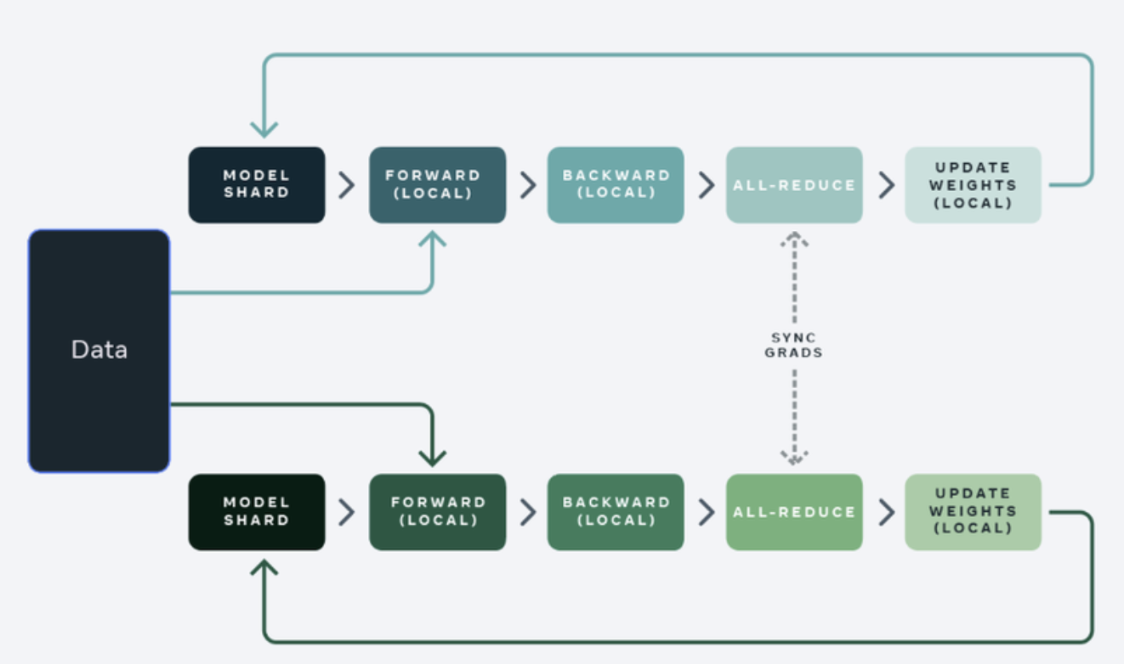
Introduction to Data Parallelism (DP)
Because each GPU computes gradients based on a different data shard, replicas would diverge without synchronization.
The gradients computed by each GPU must be aggregated and averaged after every step.
All-Reduce efficiently sums the gradients across all nodes and broadcasts the result back, ensuring all replicas update identically.

Slide 7
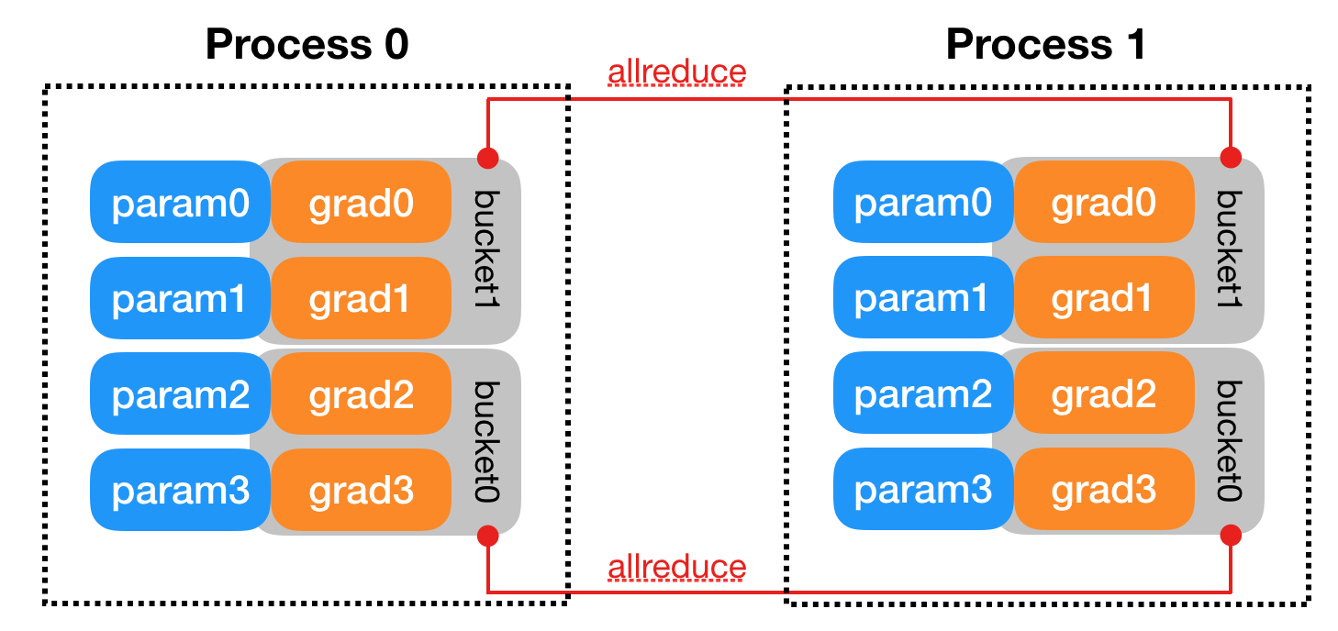
Gradient Bucketing in DDP
Launching independent All-Reduce operations for every individual parameter tensor results in network congestion.
DDP mitigates this via gradient bucketing.
Parameter gradients are organized into configurable memory buckets
The All-Reduce is only triggered when a bucket is completely filled during the backward pass.
This dramatically reduces the total number of network calls and optimizes bandwidth.
https://docs.pytorch.org/docs/stable/notes/ddp.html

Slide 8
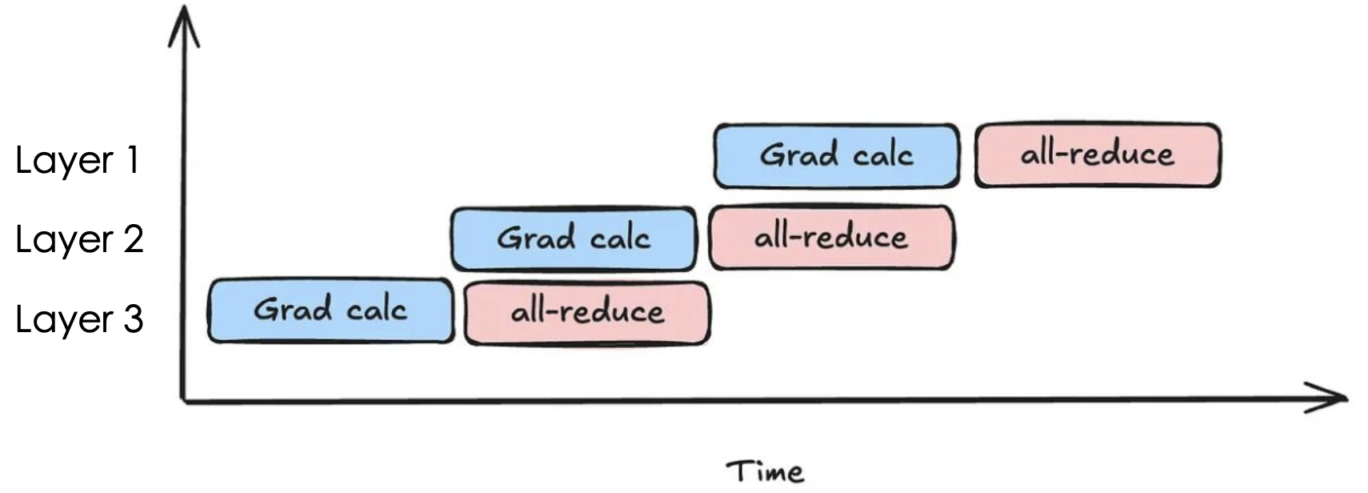
Compute-Communication Overlap in DDP
Communications (red blocks) are not on the backward compute critical path (blue blocks). Thus good compute communication overlap capability.
1. grad_calc(layer i, gpu k) depends only on grad_calc(layer i -1, gpu k)
2. All-reduce(layer i, gpu k) depends on grad_calc(layer i, all gpus)

Slide 9
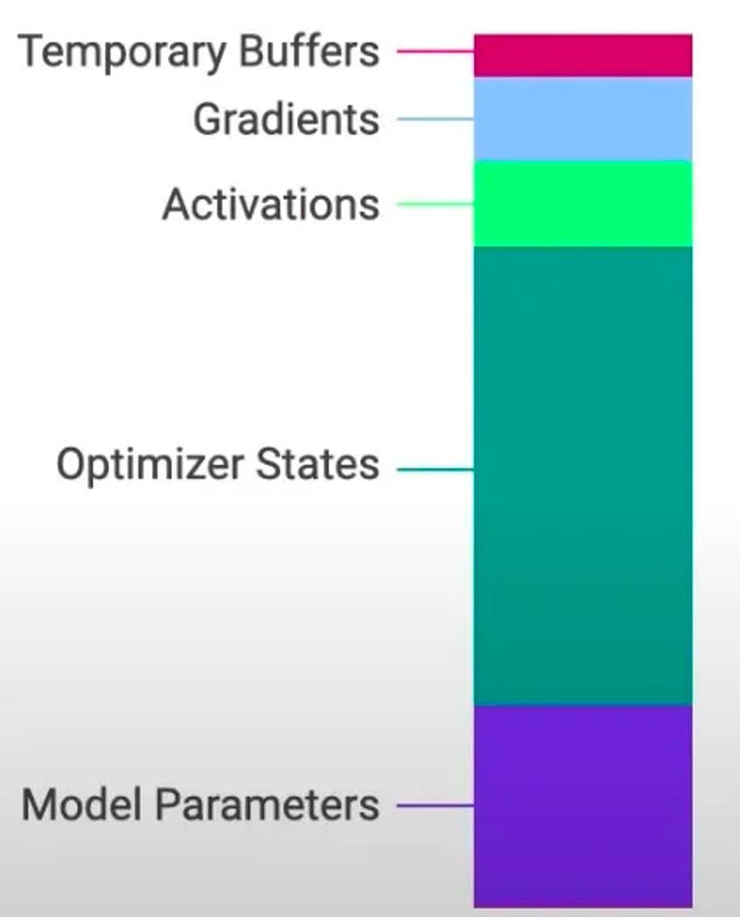
The Memory Crisis in LLM Training
Memory consumption comes from two folds:
Storing the models weights in memory (usually in FP16)
Storing the optimizer states (momentum and variance) in memory (usually inFP32, for accuracy purpose)
For a 7B model, storing the model’s weights in FP16 requires 14GB memory. The backward pass generates gradients requiring an additional 14GB.
Storing the optimizer states in FP32 requires 56G memory.
In total 70G memory used! Note that H100 GPU only has 80G memory
Memory composition during LLM training

Slide 10
The Memory Crisis in LLM Training
Standard DDP suffers from severe memory redundancy.
Training across 8 GPUs forces the cluster to maintain 8 complete copies of model weights, gradients, and massive FP32 optimizer states.
Redundant replication consumes High Bandwidth Memory without providing additional computational capacity.
Strictly limits the maximum trainable model size to the capacity of a single GPU, creating an insurmountable barrier for LLMs.

Slide 11
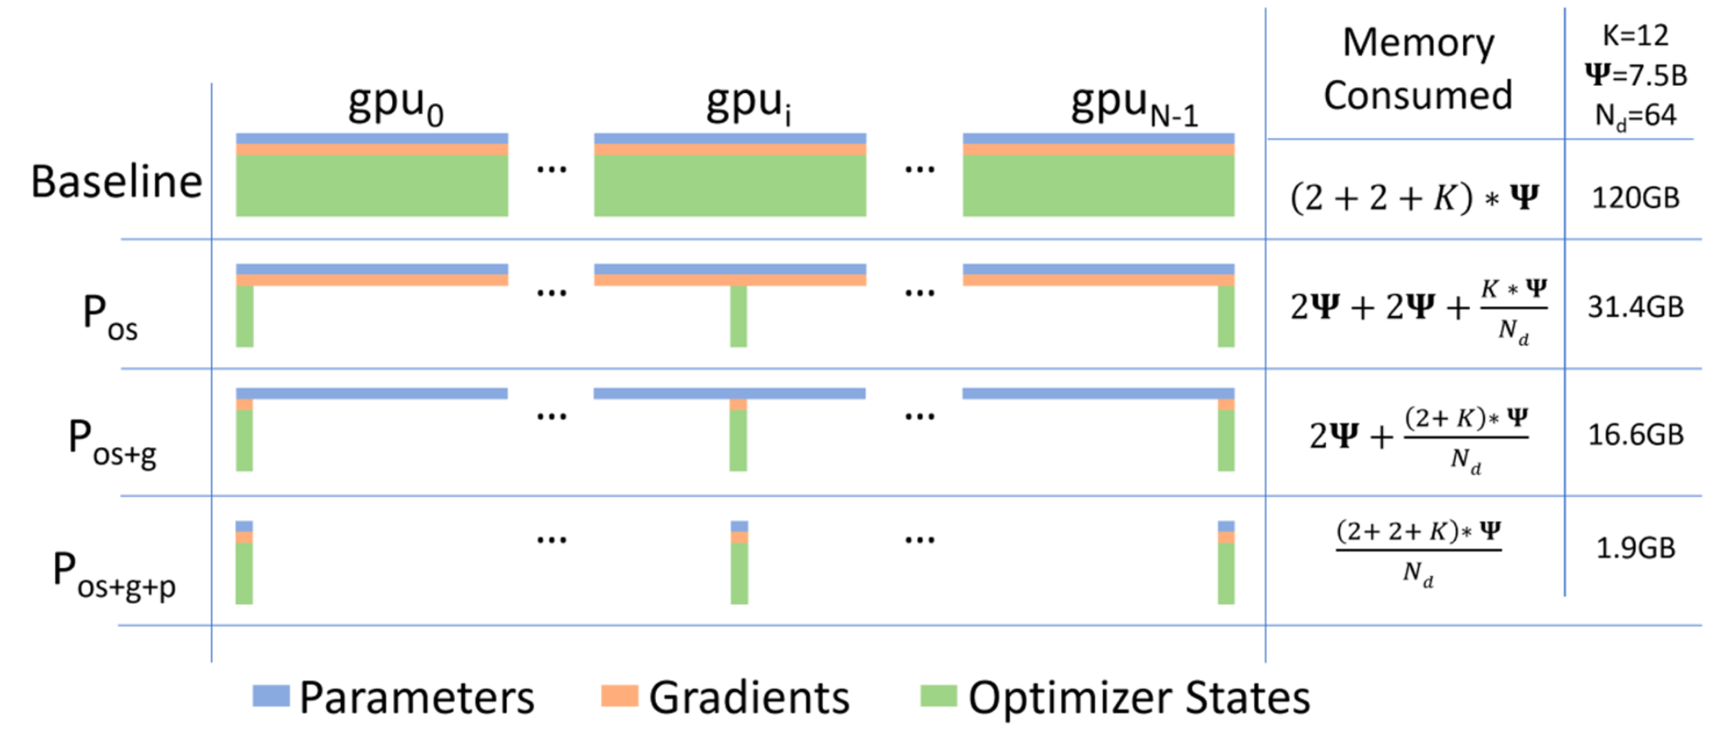
ZeRO – Solving the Memory Overhead Issue of DP
Core idea of ZeRO (Zero Redundancy Optimizer)
Split up the expensive parts (state) and use the reduce-scatter equivalence.

Slide 12
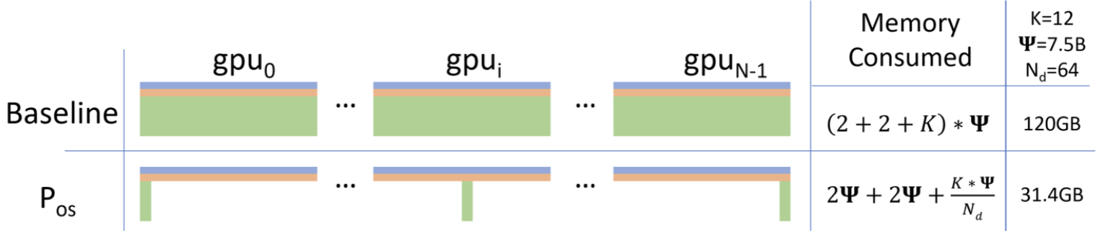
ZeRO Stage 1: Optimizer State Sharding (P_{os})
Split up the optimizer state (first + second moments) across GPUs
Each worker has the full parameters, and computes gradient on its subset of data.
Each worker is responsible for updating a shard of the full parameters

Slide 13
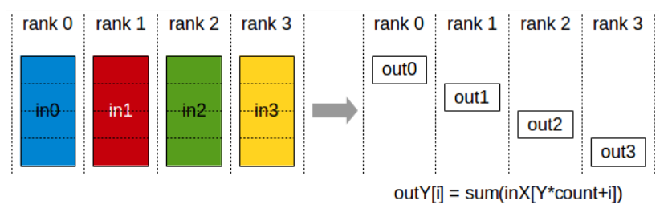
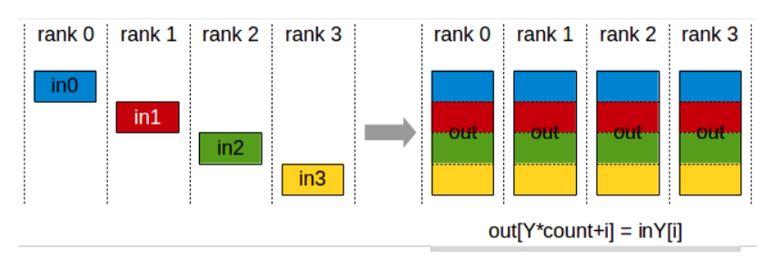
ZeRO Stage 1: Optimizer State Sharding (P_{os})
Each worker computes a full gradient on their subset of the data
ReduceScatter the gradients: each worker gets the full gradient corresponding to their parameter shard (#params communication cost).
Each worker updates their param using their gradient + state.
Perform an AllGather to synchronize params
#params communication cost

Slide 14
Compare Naïve DP with ZeRO-1
ZeRO stage 1 is free (in the bandwidth limited regime) memory wins.
 | Naïve DDP | ZeRO-1
Communication Primitive | One all-reduce (full gradients) | One reduce-scatter (collect gradient slices) + one all-gather (sync the params)
Communication Cost | 2x #params | 2x #params
Memory | (4 + K) x #params | (4 + K / nGPUs) x #params
K is the bytes used by optimizer states for each param (typically 12 for FP32 momentum)

Slide 15
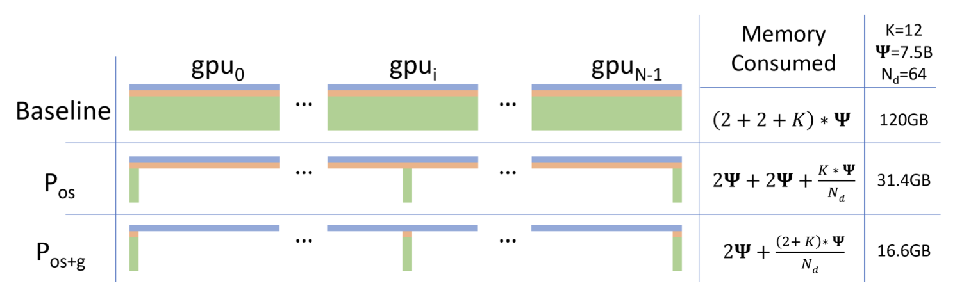
ZeRO Stage-2: Optimizer State + Gradient Sharding
High-level idea:
Also keep the gradients (pink slices) sharded across the machines.
Use the same (rough) tricks as stage 1.
Complexity: we can never instantiate a full gradient vector, but each worker must compute a full gradient (since we’re data parallel)

Slide 16
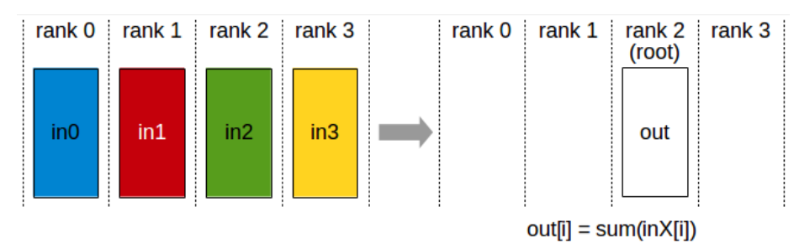
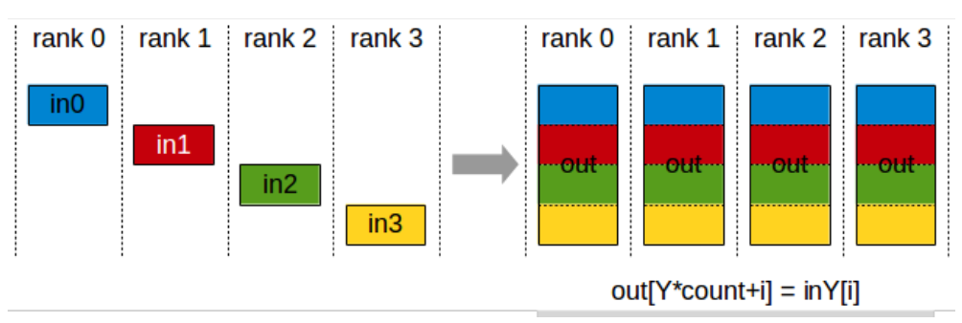
ZeRO Stage-2: Optimizer State + Gradient Sharding
Step 1. Everyone incrementally goes backward on the computation graph
Step 1a. After computing a layer’s gradients, immediately reduce to send this to the right worker.
Step 1b. Once gradients are not needed in the backward graph, immediately free it.
Step 2. Each machine updates their param using their gradient + state.
Step 3. All Gather the parameters.

Slide 17
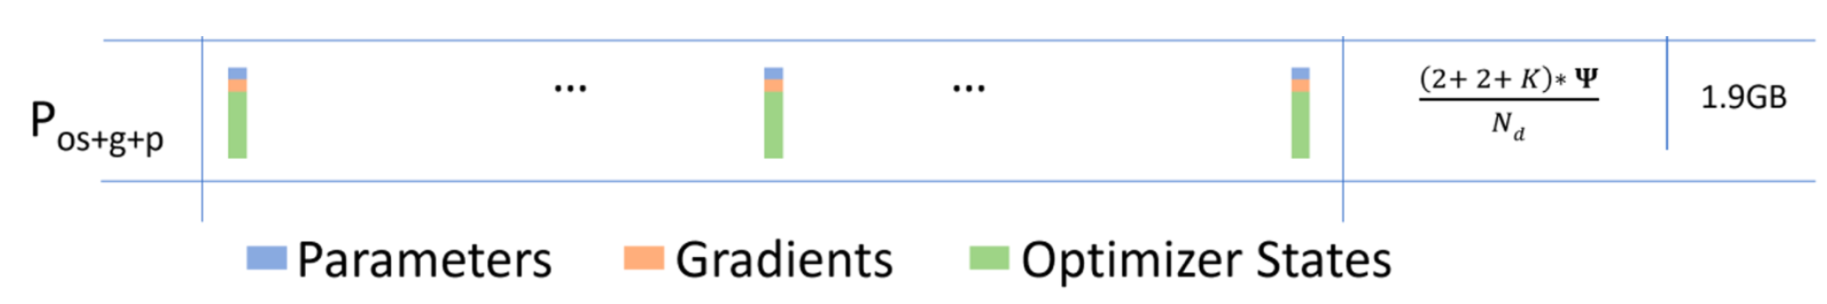
ZeRO Stage-3 (aka FSDP) Shard Everything
High-level ideas
Shard everything, including parameters!
Use the same “incremental communication / computation” ideas
Send and request parameters on demand while stepping through the compute graph.

Slide 18
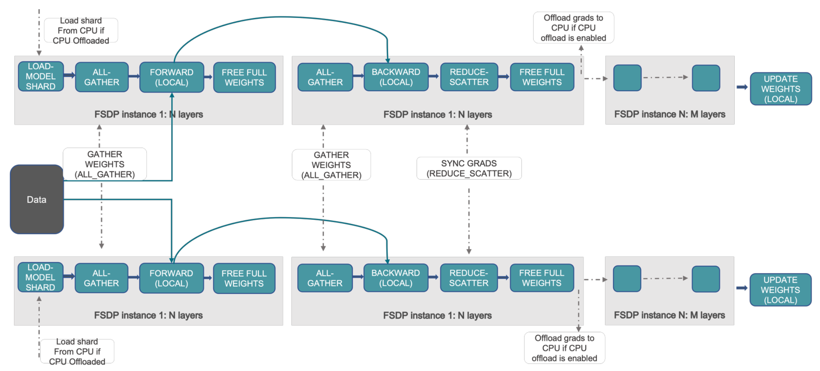
ZeRO Stage-3 (aka FSDP) Shard Everything
Communication cost – 2 all gather (#param), 1 reduce-scatter (#param).
https://pytorch.org/tutorials/intermediate/FSDP_tutorial.html

Slide 19
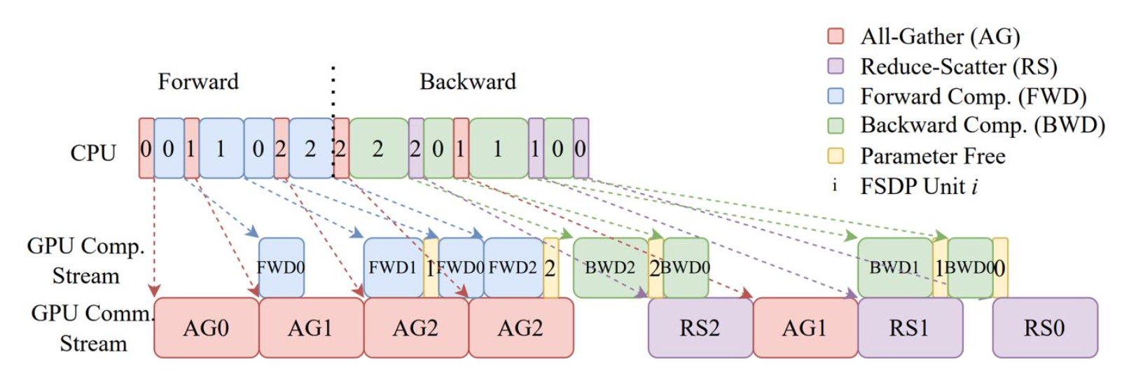
FSDP / ZeRO-3: Actual Picture
Incremental computation / communication
Parameters / gradients are requested / sent and then immediately freed
Overlapping communication and computation
The all-gathers happen all at once while forward happens, masking the comm cost.
https://arxiv.org/pdf/2304.11277.pdf

Slide 20
Communication Overhead Recap
DDP (All reduce): 2x #params
ZeRO Stage-1 / 2 (Reduce-Scatter + All-gather): 2x #params
Memory saved for free
ZeRO Stage-3 / FSDP (All-gather + Reduce-scatter + All-gather): 3x #params
More overhead

Slide 21
Revisiting GPU Memory Calculation
GPU memory consumption :=
Model parameters (in FP16) +
Gradients (FP16) +
Master weights (FP32) +
Adam momentum (FP32) +
Adam variance (FP32) +
Model Activations (This scales with the batch size)!
We will go through activation consumption more in the coming chapters

Slide 22
Conclusion
Summary: Training massive LLMs requires breaking the single-GPU memory barrier via state sharding.
ZeRO and FSDP elegantly solve capacity issues by partitioning states without sacrificing data-parallel simplicity.
The Next Bottleneck: As models reach hundreds of billions of parameters, even the pipelined layer-by-layer communication of FSDP bottlenecks the training cluster.
Solution: We must slice the actual matrix mathematics themselves -> Tensor Parallelism.

Slide 23

The Solution: FlagOS, a Unified AI Software Stack

Slide 24








https://space.bilibili.com/3546791834290849
https://github.com/flagos-ai
https://www.zhihu.com/people/95-22-20-18/posts
https://flagos.io/Home

Slide 25

Thanks for your time！

